Slide 1

University of Hertfordshire School of Physics, Engineering and Computer Science
Demonstration 7PAM2002-0509-Data Science Project 27-03-2026
Student Full Name: Vishnu Vardhan Reddy Nallamaru
Student ID: 24057022
supervisior: Vidas Regelskis

Slide 2
Lung Cancer Detection Using Deep Learning on CT Scan Images
.

Slide 3
Project Introduction
Lung cancer is one of the leading causes of cancer-related deaths worldwide
Early detection significantly increases survival rates
CT scan imaging is widely used for diagnosis
Deep learning can assist in automatic and accurate detection
Notes:
A geriatric unit at the Ohio State University Hospital is used to treat elderly patients with a variety of healthcare needs. On 09/11/2025 the ward was full and a 79 year old patient (75896-2015) who had recently emigrated from Pakistan was admitted with shortness of breath, a low-grade fever (38.5oC) and a productive cough. The patient was a smoker and reported being in good health otherwise. The patient was administered amoxicillin 500 mg orally 3 times a day for suspected pneumonia and sent for a chest X-ray. The chest X-ray revealed substantial infiltrates in the lower left lung. The patient subsequently developed a fever of 40.0oC, abdominal pain and cramps, followed by profuse watery diarrhoea. The patient was immediately moved to an isolation room and was started on oral metronidazole (400mg every 6 hours). A faecal specimen was taken along with a blood sample and these were sent for microscopy, culture, and sensitivities, and haematological and biochemical assays respectively (Table 1). Analysis of faecal specimen from patient 75896-2015 identified a gastrointestinal pathogen and the diagnosis of the infection was confirmed with a positive faecal Glutamate Dehydrogenase (GDH) test. The consultant microbiologist then ordered antimicrobial susceptibilities be performed and molecular typing (PCR ribotyping; Figure 1) of the suspected causative pathogen. Once the blood data had been reviewed by the Consultant, the patient was immediately withdrawn from metronidazole therapy and started on oral vancomycin (125 mg every 6 hours). The patient deteriorated rapidly. A computerised tomography scan revealed dilation of the colon (8 cm) and thickness of the colon wall of 15 mm. Colonoscopy revealed the presence of visible raised, yellow plaques ranging from 2 to 10 mm in diameter scattered over the colorectal mucosa. The patient was continually administered fluids and electrolytes throughout the hospital admission. Six other patients on the geriatric ward (aged 85-99) developed similar severe gastrointestinal symptoms and were treated in an identical manner to patient 75896-2015. All of the patients rapidly developed signs of sepsis and despite emergency colectomy surgery, all patients died as a consequence of their infections. The clinical microbiology laboratory performed antimicrobial susceptibilities on gastrointestinal pathogens isolated from all patients (Table 2).
Once the patient’s medical records were obtained, it became apparent that he had finished a 6-month course of antimicrobial therapy for pulmonary tuberculosis (pyrazinamide, ethambutol, isoniazid, and rifampicin) 6-months previously in Pakistan and been declared free of Mycobacterium tuberculosis prior to emigrating.

Slide 4
Research Questions ?
1.Can deep learning models accurately detect and classify lung cancer (normal, benign, malignant) using CT scan images from the IQOTH/NCCD dataset?
2. deep learning architecture (CNN, transfer learning models, or advanced vision models) provides the highest accuracy and reliability for medical image classification?
3.How effectively can pre-processing and data augmentation techniques improve classification performance on limited medical imaging data?

Slide 5
Problem Statement
Problem Statement
Manual analysis of CT scans is time-consuming and complex
Requires highly skilled radiologists
Risk of human error and misclassification
Class imbalance in medical datasets affects model performance
Need for an automated, accurate, and reliable detection system
Notes:
TB- not fully being cured in Pakistan, could lead to secondary colonic TB via the ingestion of sputum containing the pathogenic organism, mycobacterium tuberculosis(Park et al., 2021) from pulmonary TB(Chakinala & Khatri, 2020). Hence why he experienced abdominal pain and cramps, plaque deposits in the colon (colonoscopy) and inflammation of the colon 8mm to15mm by granulaomas(immune cells) (Chakinala & Khatri, 2020) Non-specific symptoms, seems to mimic other infections, lead to misdiagnosis.
Pneumonia- infection of the lungs- symptoms shortness of breath and a productive cough. X-ray showed damage in the lower left lung- potentially due to inflammation in the alveoli, which can allow fluid into the lungs(National Heart, Lung and Blood Institute, 2022)
Cholera- causative pathogen is the bacteria vibrio cholerae from food and water, that is transmitted via the faecal-oral route
Could be spread due to poor hygiene in the hospital
Causes diarrhoea, as seen in the patient
Many endemics in Asia- patient recently came to the UK from Pakistan(Ojeda Rodriguez & Kahwaji, 2024)
Tuberculosis (TB) treatment, especially using rifampicin, can affect C. difficile by disrupting the gut microbiome, which may increase the risk of developing C. difficile infection (CDI). While other TB drugs have little effect, rifampicin's broad-spectrum activity can suppress beneficial bacteria, and some C. difficile strains can develop high-level resistance to it, complicating treatment for both TB and CDI. Patients on TB therapy with diarrhea should be evaluated for CDI, particularly if they are receiving (Obuch-Woszczatyński et al., 2013)

Slide 6
Objectives
To develop a deep learning model for lung cancer detection
To classify CT scan images into:
Benign
Malignant
Normal
To handle class imbalance using class weights
To compare the performance of multiple models
To identify the most effective model for accurate diagnosis
Notes:
TB- not fully being cured in Pakistan, could lead to secondary colonic TB via the ingestion of sputum containing the pathogenic organism, mycobacterium tuberculosis(Park et al., 2021) from pulmonary TB(Chakinala & Khatri, 2020). Hence why he experienced abdominal pain and cramps, plaque deposits in the colon (colonoscopy) and inflammation of the colon 8mm to15mm by granulaomas(immune cells) (Chakinala & Khatri, 2020) Non-specific symptoms, seems to mimic other infections, lead to misdiagnosis.
Pneumonia- infection of the lungs- symptoms shortness of breath and a productive cough. X-ray showed damage in the lower left lung- potentially due to inflammation in the alveoli, which can allow fluid into the lungs(National Heart, Lung and Blood Institute, 2022)
Cholera- causative pathogen is the bacteria vibrio cholerae from food and water, that is transmitted via the faecal-oral route
Could be spread due to poor hygiene in the hospital
Causes diarrhoea, as seen in the patient
Many endemics in Asia- patient recently came to the UK from Pakistan(Ojeda Rodriguez & Kahwaji, 2024)
Tuberculosis (TB) treatment, especially using rifampicin, can affect C. difficile by disrupting the gut microbiome, which may increase the risk of developing C. difficile infection (CDI). While other TB drugs have little effect, rifampicin's broad-spectrum activity can suppress beneficial bacteria, and some C. difficile strains can develop high-level resistance to it, complicating treatment for both TB and CDI. Patients on TB therapy with diarrhea should be evaluated for CDI, particularly if they are receiving (Obuch-Woszczatyński et al., 2013)

Slide 7
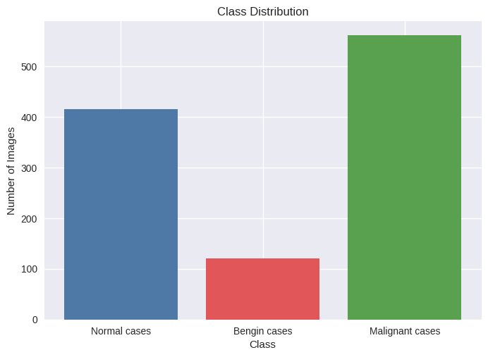
Dataset Overview
Dataset: IQ-OTH/NCCD Lung Cancer Dataset
Data type: CT scan images
Total classes: 3 (Benign, Malignant, Normal)
Images labelled by medical experts
Dataset contains class imbalance

Slide 8
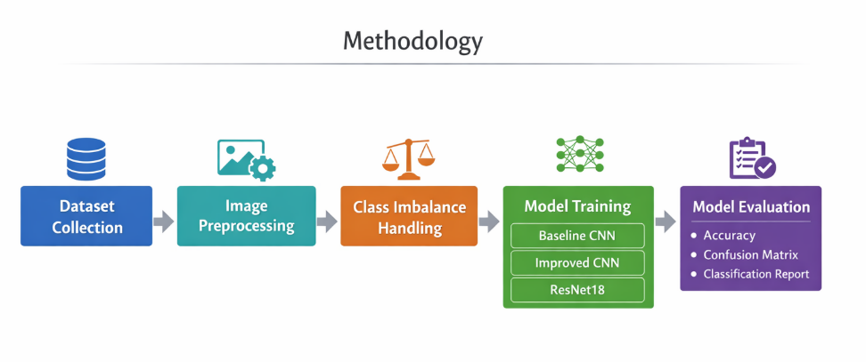
Methodology
Project Workflow:
1. Dataset collection
2. Image preprocessing
3. Class imbalance handling
4. Model development
-> Baseline CNN
-> Improved CNN
-> ResNet18
5. Model evaluation
-> Accuracy
-> Confusion Matrix
-> Classification Report

Slide 9
Data Preprocessing & Class Imbalance
Preprocessing Steps:
Images resized based on model requirements:
120×120 → Baseline CNN
160×160 → Improved CNN
224×224 → ResNet
Pixel values normalized
Train–validation split performed

Slide 10
Data Preprocessing & Class Imbalance
Handling Class Imbalance:
Applied class weights during training
Higher weight assigned to minority class
Class Weights:
Benign: 9.14
Malignant: 1.95
Normal: 2.63

Slide 11
Model 1 – Baseline CNN
Architecture Overview:
Input size: 120 × 120 × 3
3 Convolutional layers (32 → 64 → 128 filters)
ReLU activation function
Max Pooling after each convolution
Adaptive Average Pooling
Fully Connected Layer (128 → 3 classes)
Dropout (0.5) to reduce overfitting

Slide 12
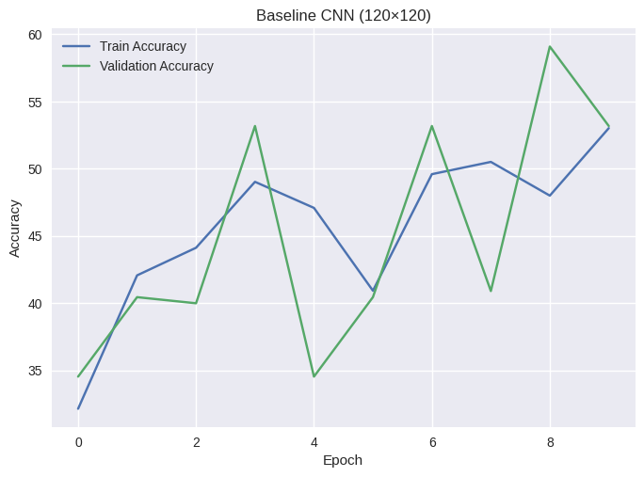
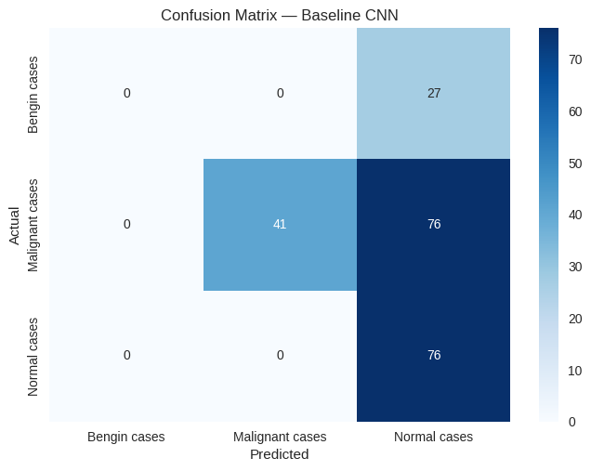
Baseline CNN Results
Training accuracy improved over epochs
Validation accuracy remained low (~50–60%)
Model struggled with generalisation
Poor performance on benign class

Slide 13
Model 2 – Improved CNN
Key Improvements Over Baseline:
Input size increased to 160 × 160 × 3
Added Batch Normalization after each convolution
Deeper network (4 convolutional layers)
Increased filters (up to 256)
Better feature extraction capability

Slide 14
Model 2 – Improved CNN
Architecture Overview:
Conv → BatchNorm → ReLU → MaxPool (repeated)
Adaptive Average Pooling
Fully Connected Layer (256 → 3 classes)
Dropout (0.5)

Slide 15
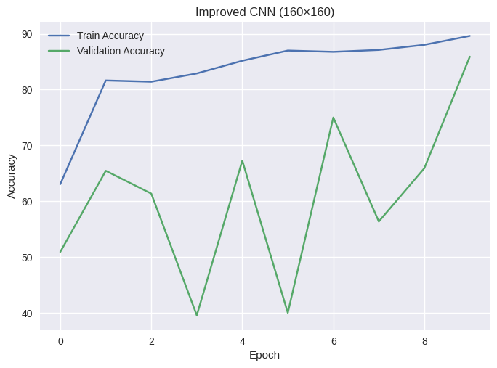
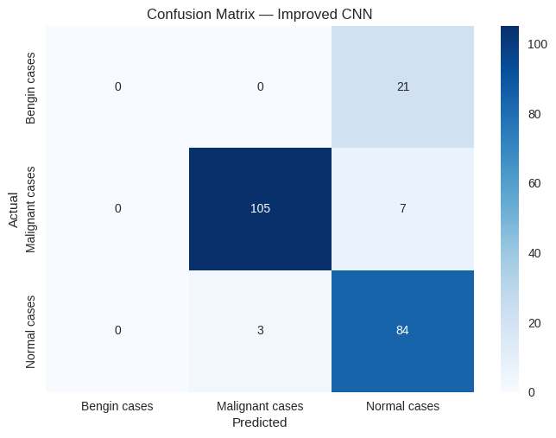
Improved CNN Results
Validation accuracy significantly improved (~85–90%)
Better generalisation compared to baseline
Improved detection of malignant cases
Reduced misclassification overall

Slide 16
Model 3 – ResNet18
Why ResNet18?
Deep neural network with residual connections
Solves vanishing gradient problem
Enables training of deeper architectures
Pre-trained model improves performance

Slide 17
Model 3 – ResNet18
Architecture Overview:
Input size: 224 × 224 × 3
Multiple convolutional layers with skip connections
Feature extraction using residual blocks
Fully connected layer for 3-class classification

Slide 18
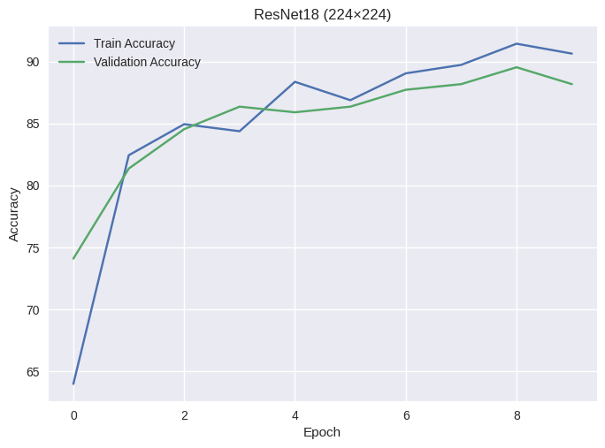
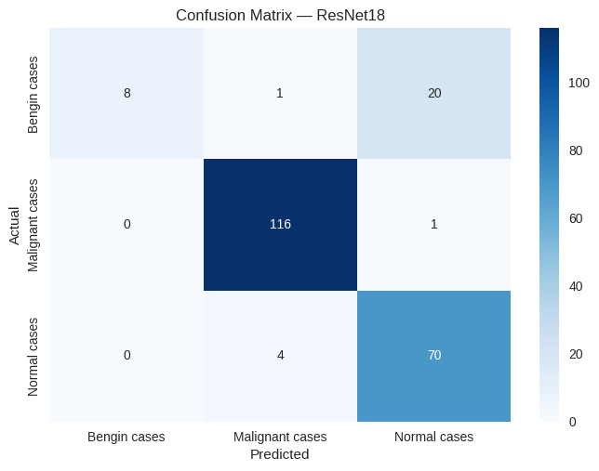
ResNet18 Results
High training accuracy (~91–92%)
Strong validation accuracy (~88–90%)
Stable learning with minimal overfitting
Excellent performance on malignant cases

Slide 19
Model Comparison & Analysis
Model | Accuracy | Key Observation
Baseline CNN | ~50–60% | Underfitting, poor generalisation
Improved CNN | ~85–90% | Significant improvement
ResNet18 | ~88–90% | Best performance
Performance improves with model complexity
Deeper networks extract better features
Class imbalance affects benign classification
ResNet provides the most stable and accurate results

Slide 20
Conclusion
Deep learning models can effectively detect lung cancer from CT scans
Improved CNN significantly outperformed the baseline model
ResNet18 achieved the best performance (~90% accuracy)
High accuracy in detecting malignant cases, which is critical in healthcare
Q&A: 👉 Thank You 👉 Any Questions?

